Slide 1
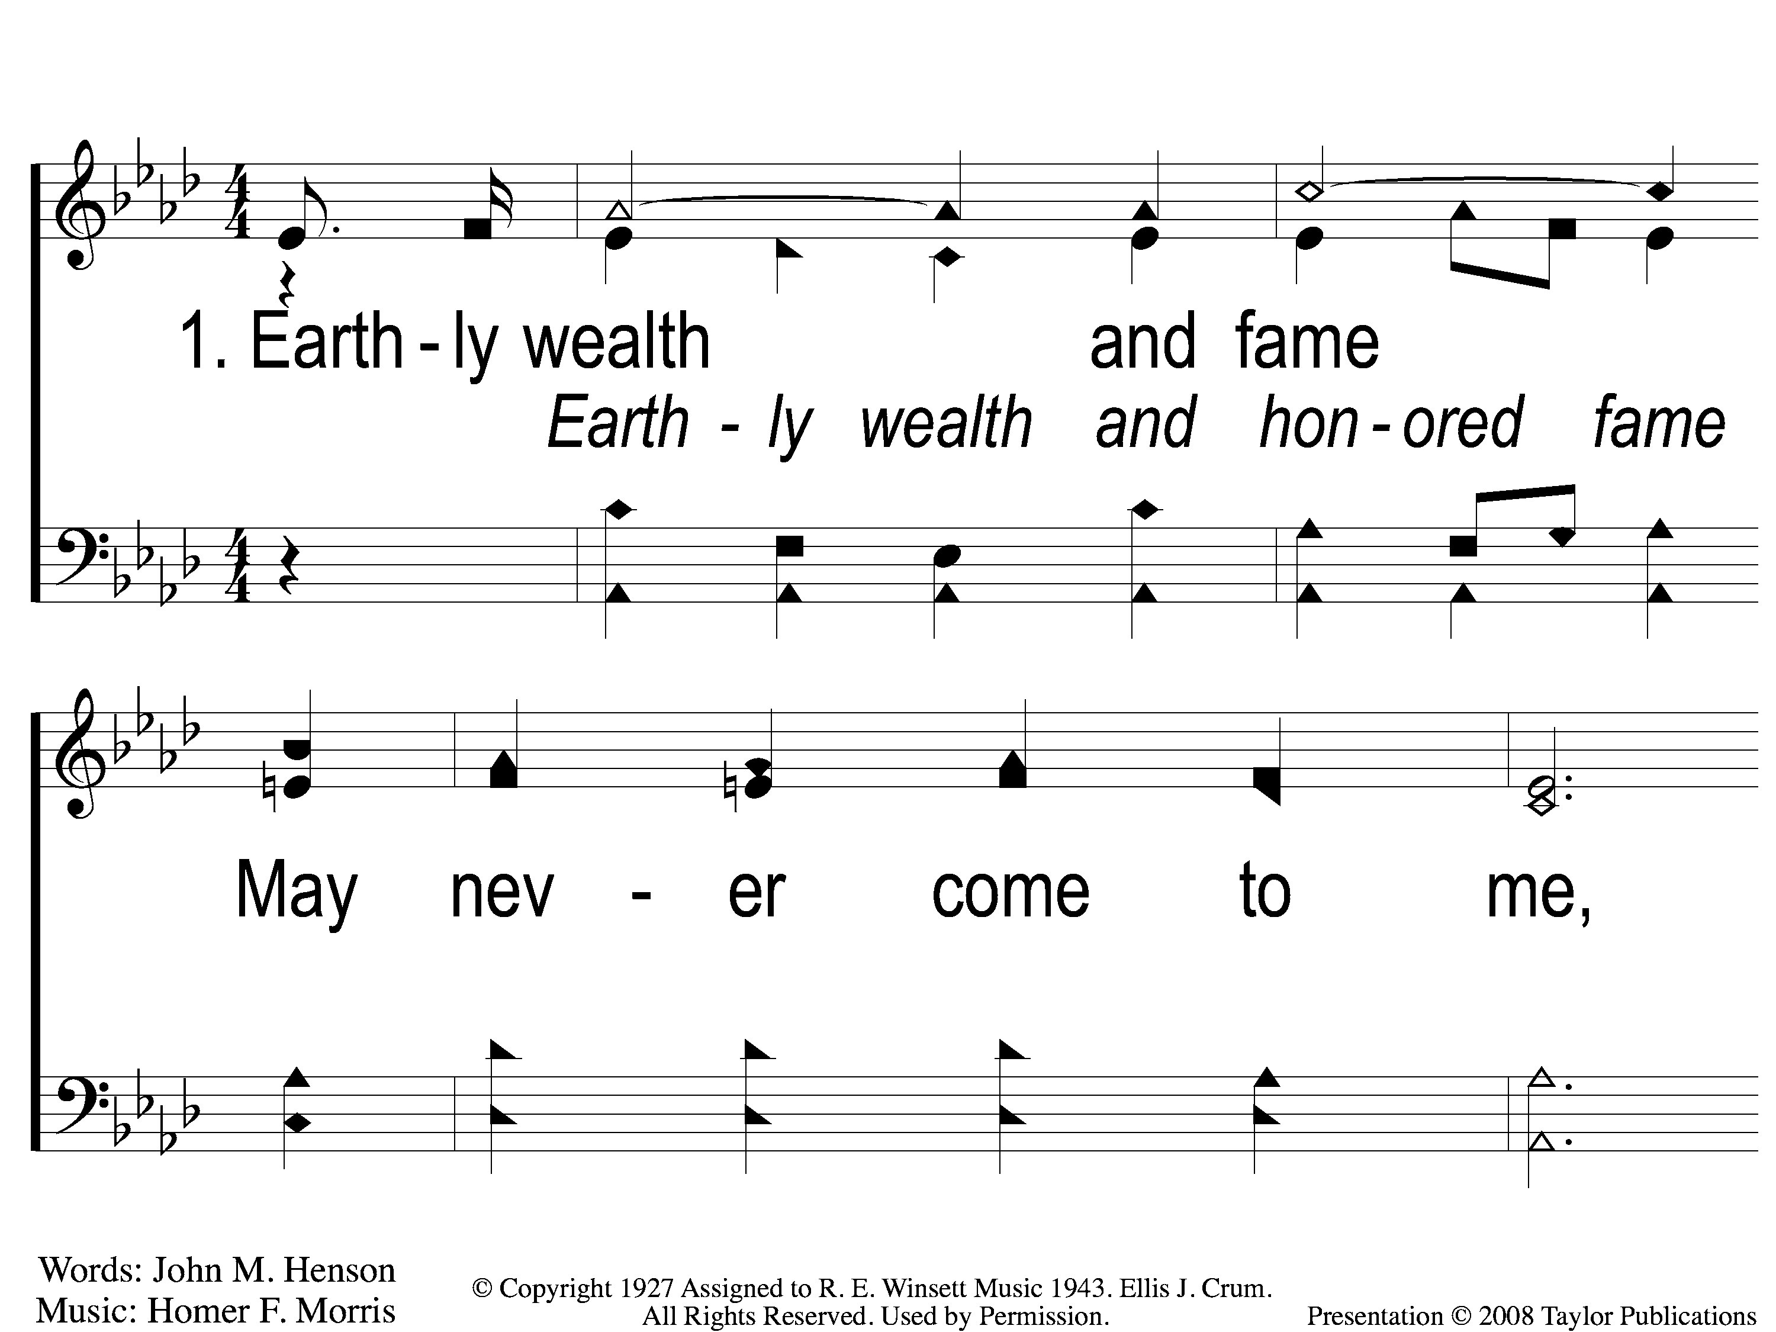
1-1 Anywhere is Home
Anywhere Is Home
24

Slide 2
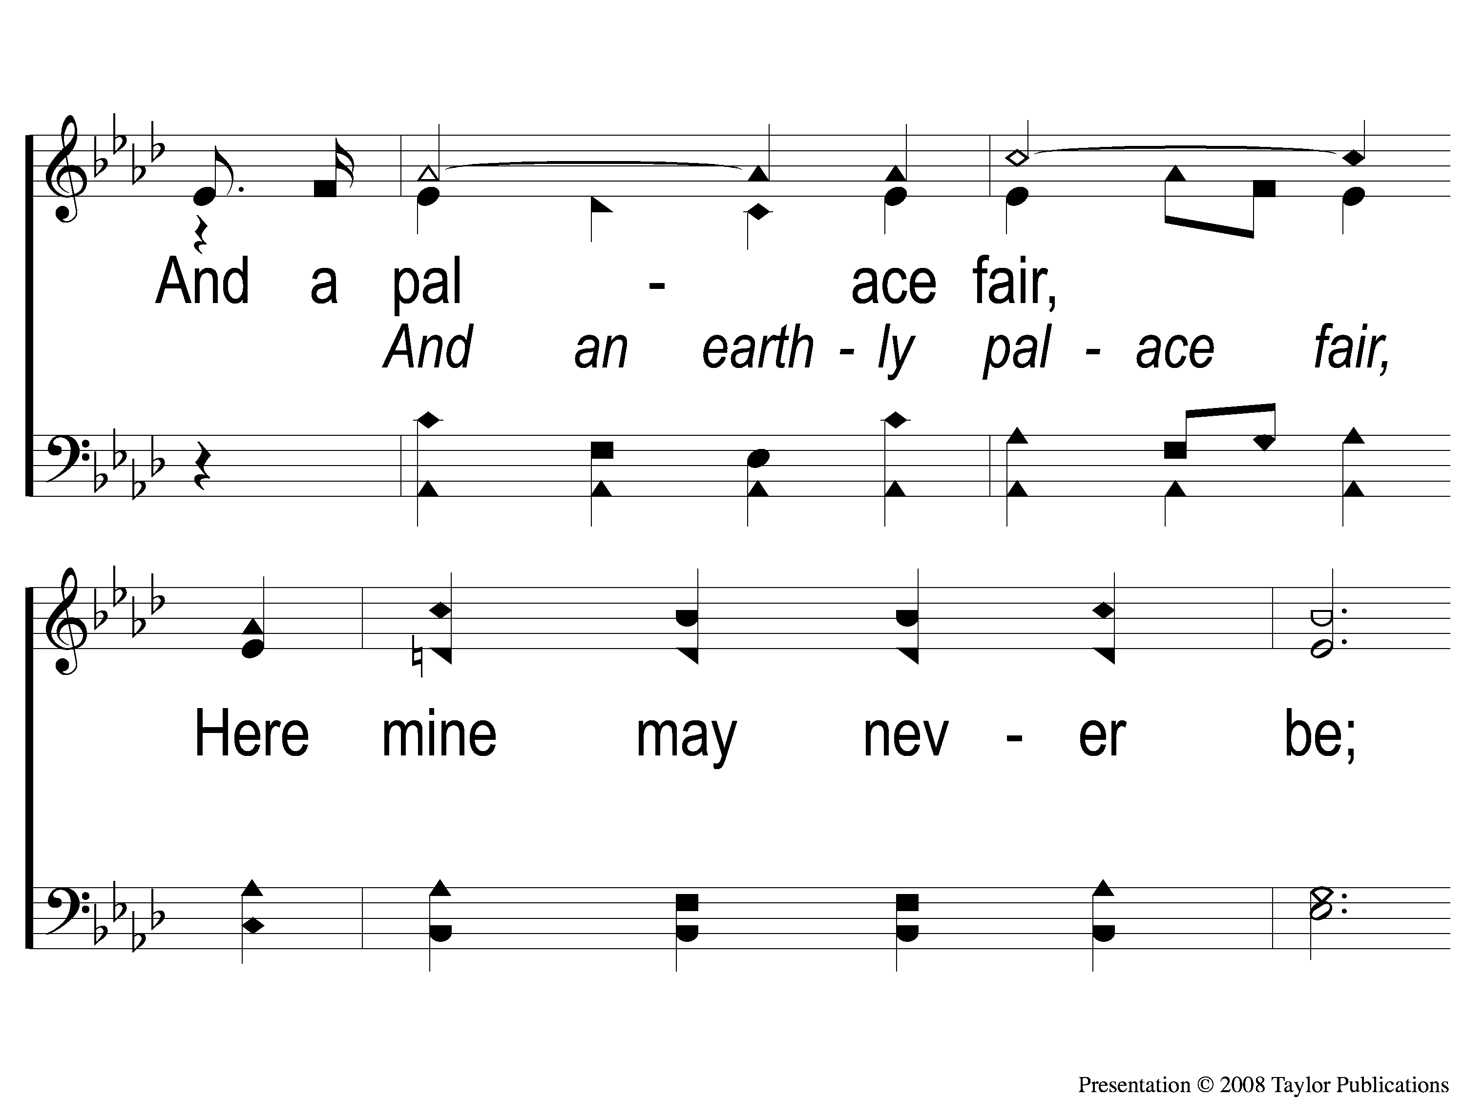
1-2 Anywhere is Home
Anywhere Is Home
24

Slide 3
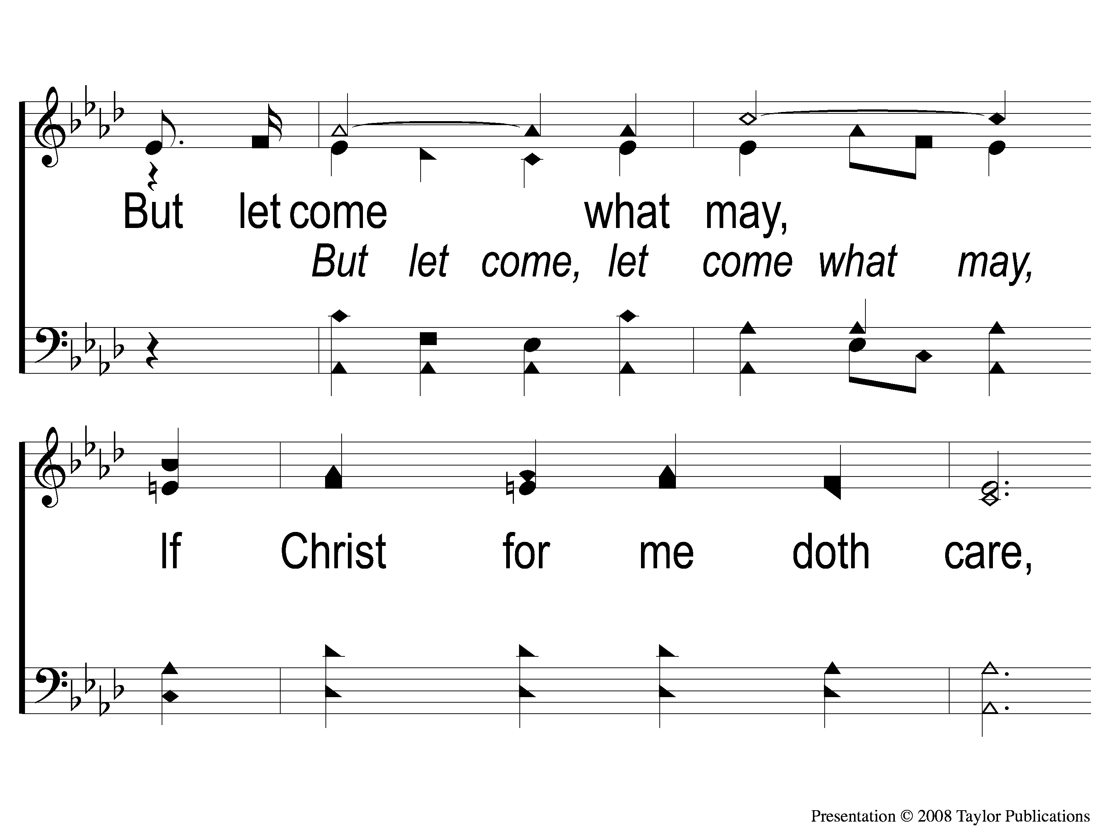
1-3 Anywhere is Home
Anywhere Is Home
24

Slide 4
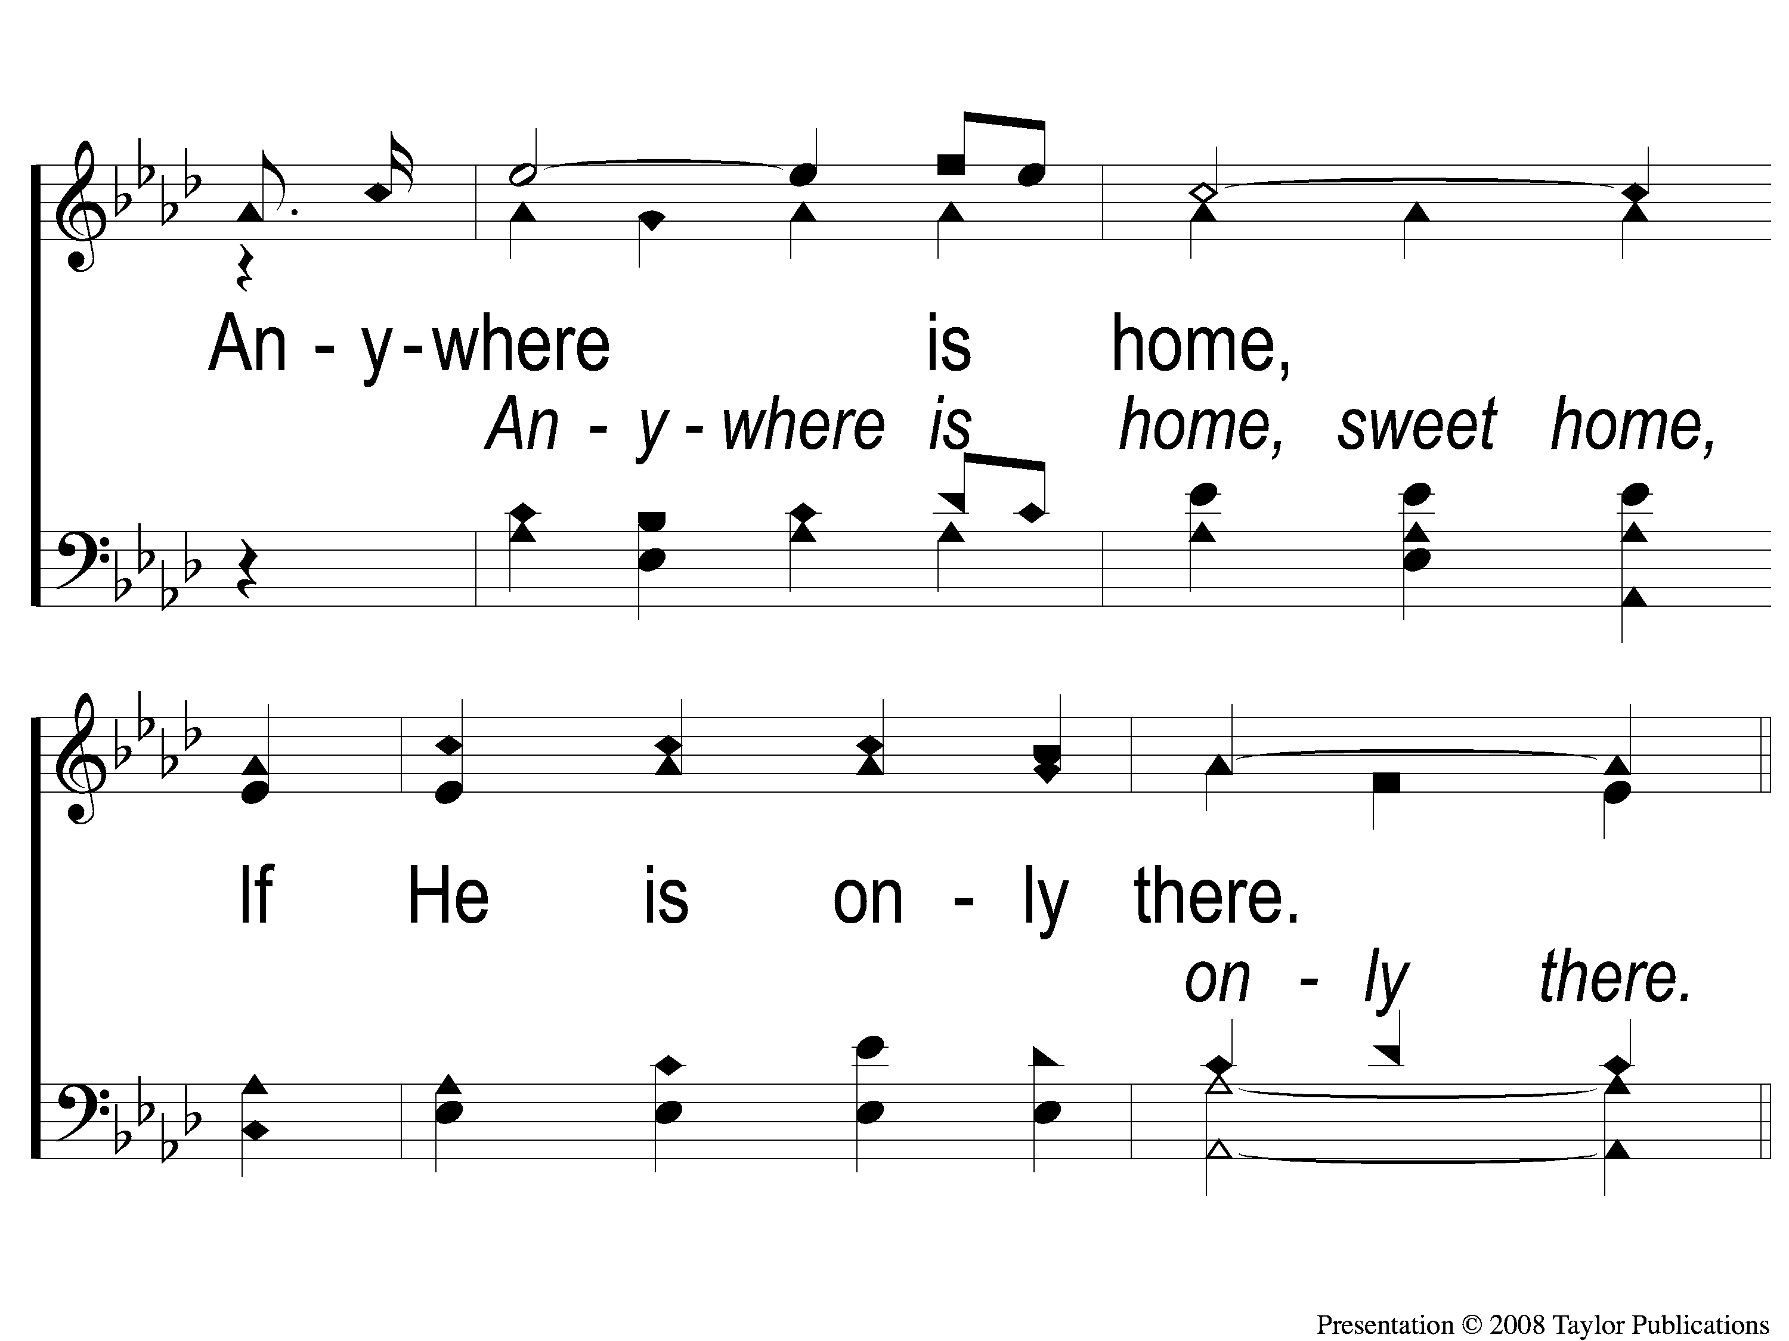
1-4 Anywhere is Home
Anywhere Is Home
24

Slide 5
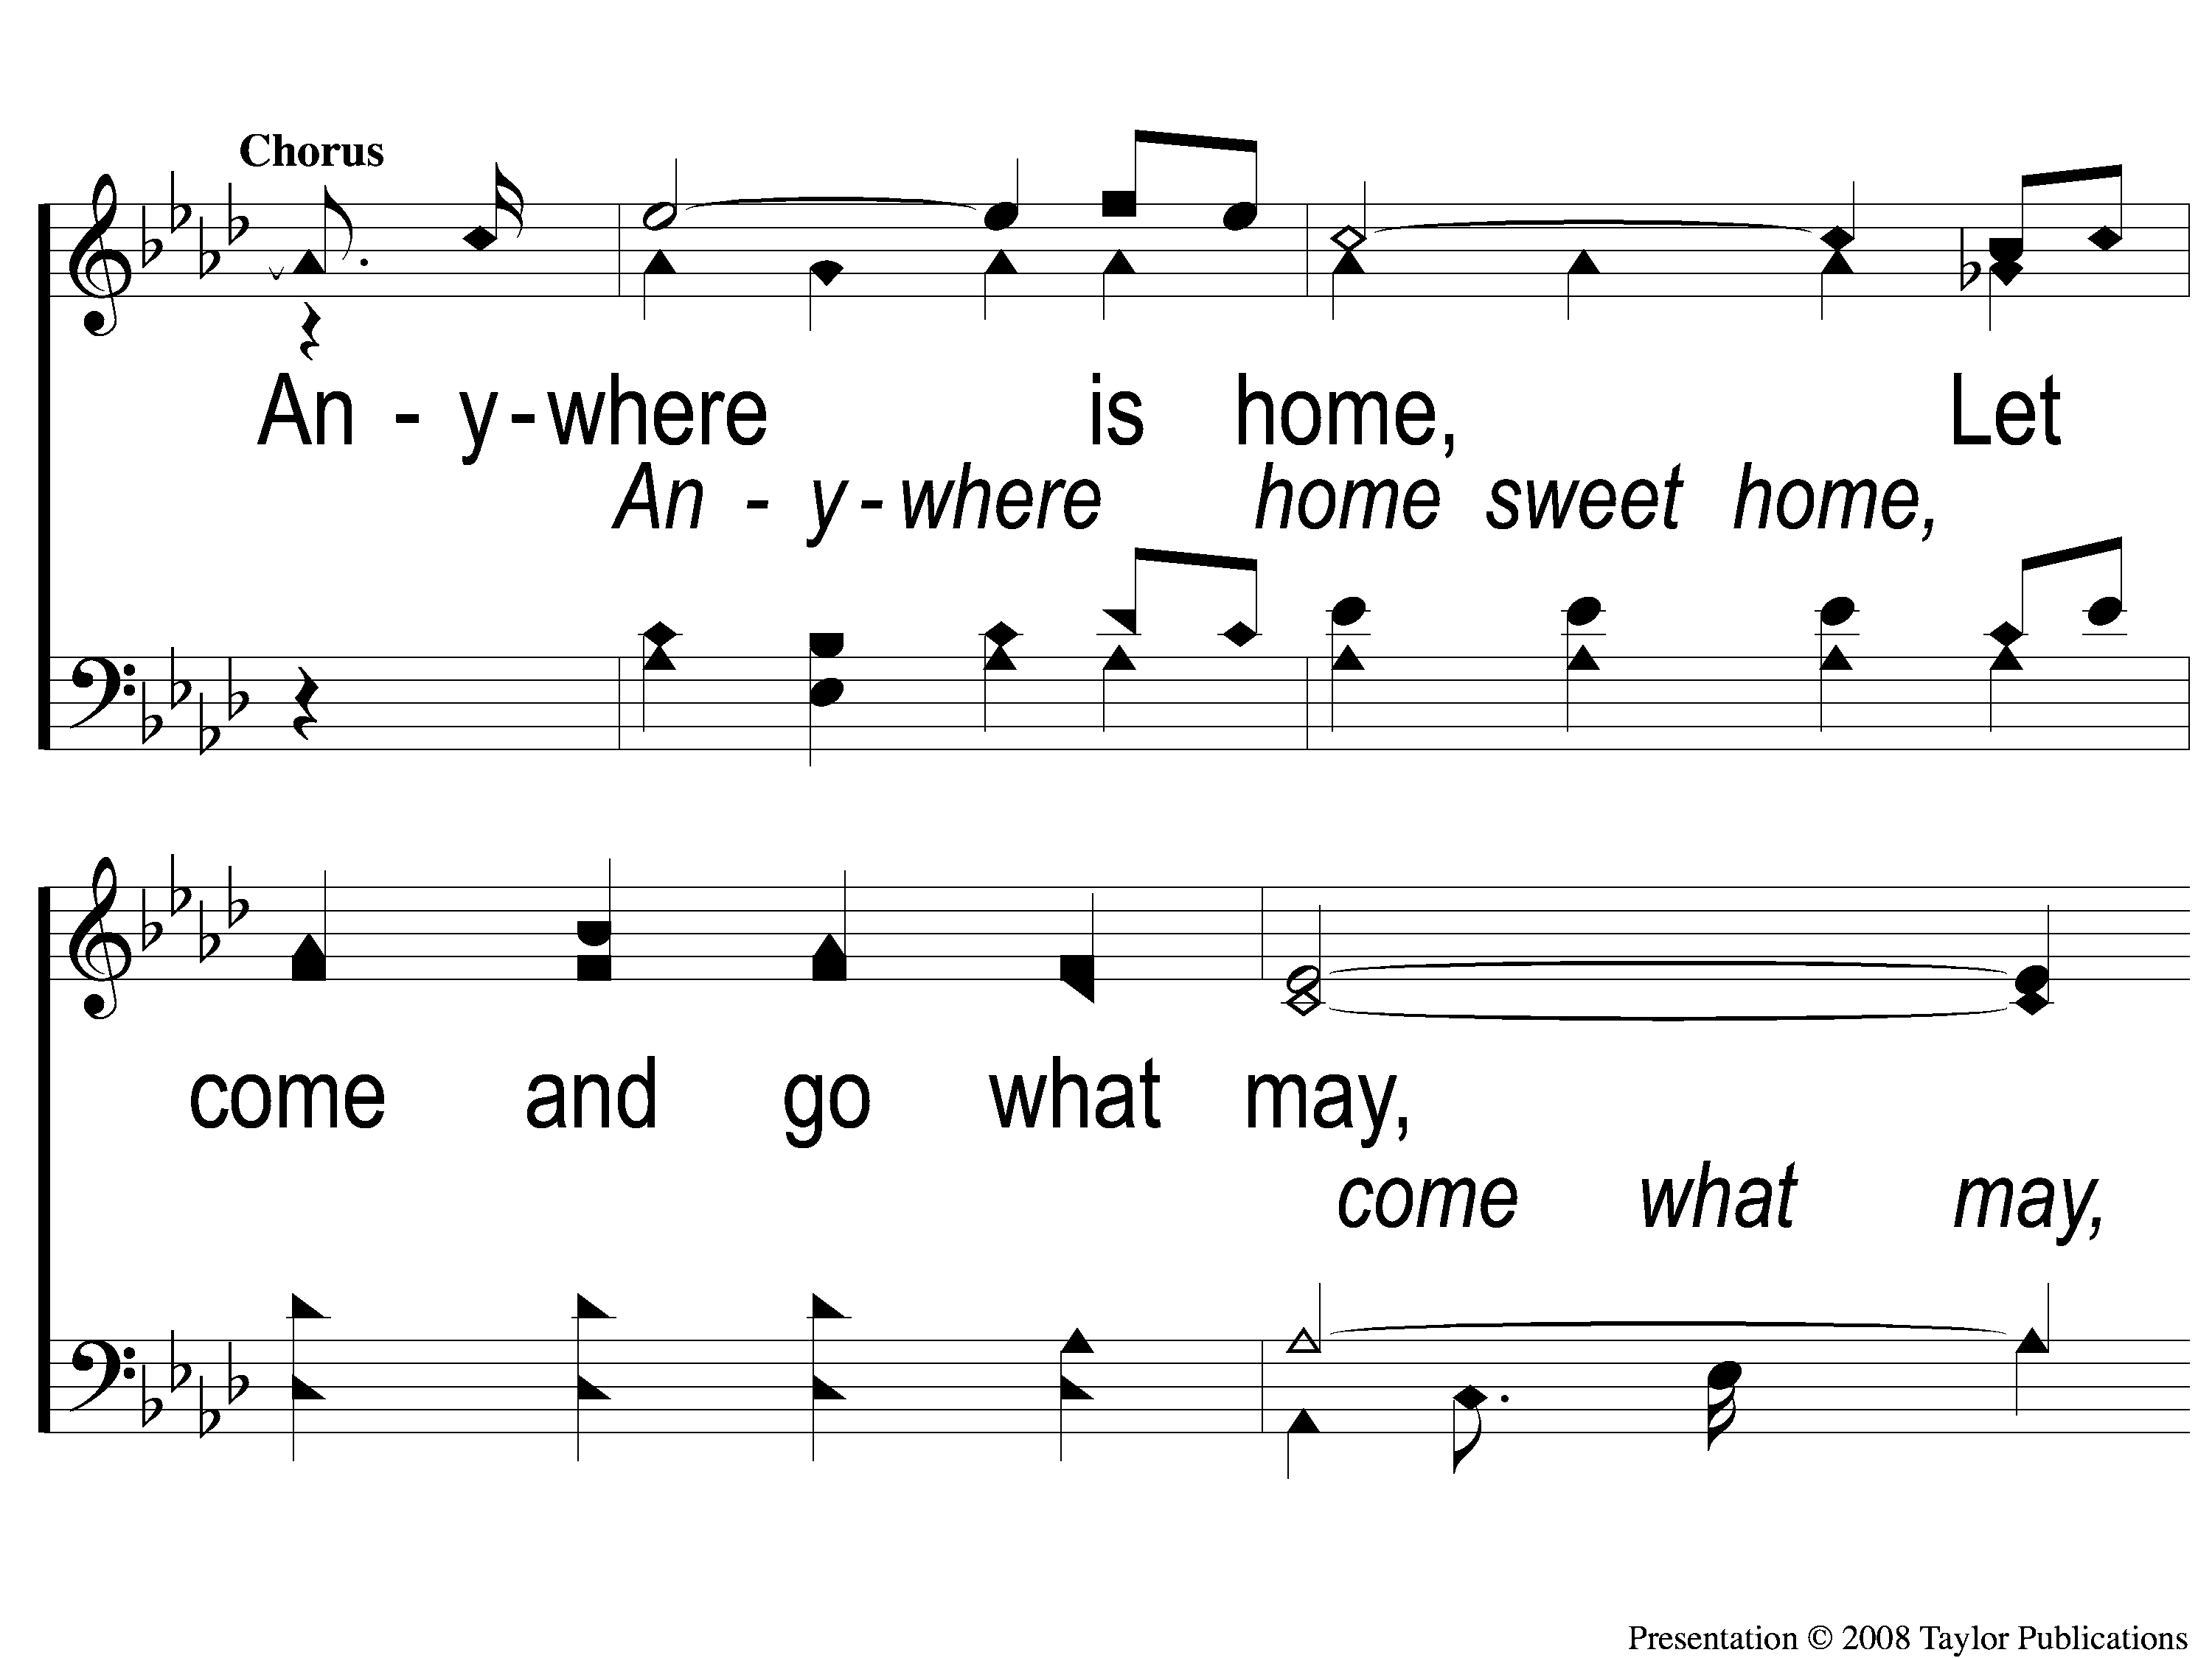
C-1 Anywhere is Home
Anywhere Is Home
24

Slide 6
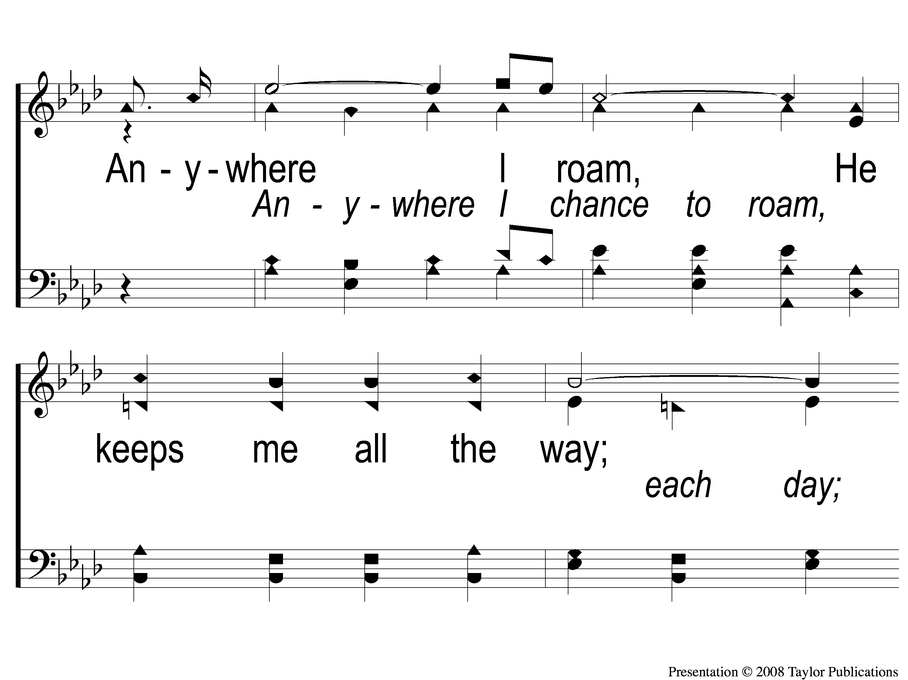
C-2 Anywhere is Home
Anywhere Is Home
24

Slide 7
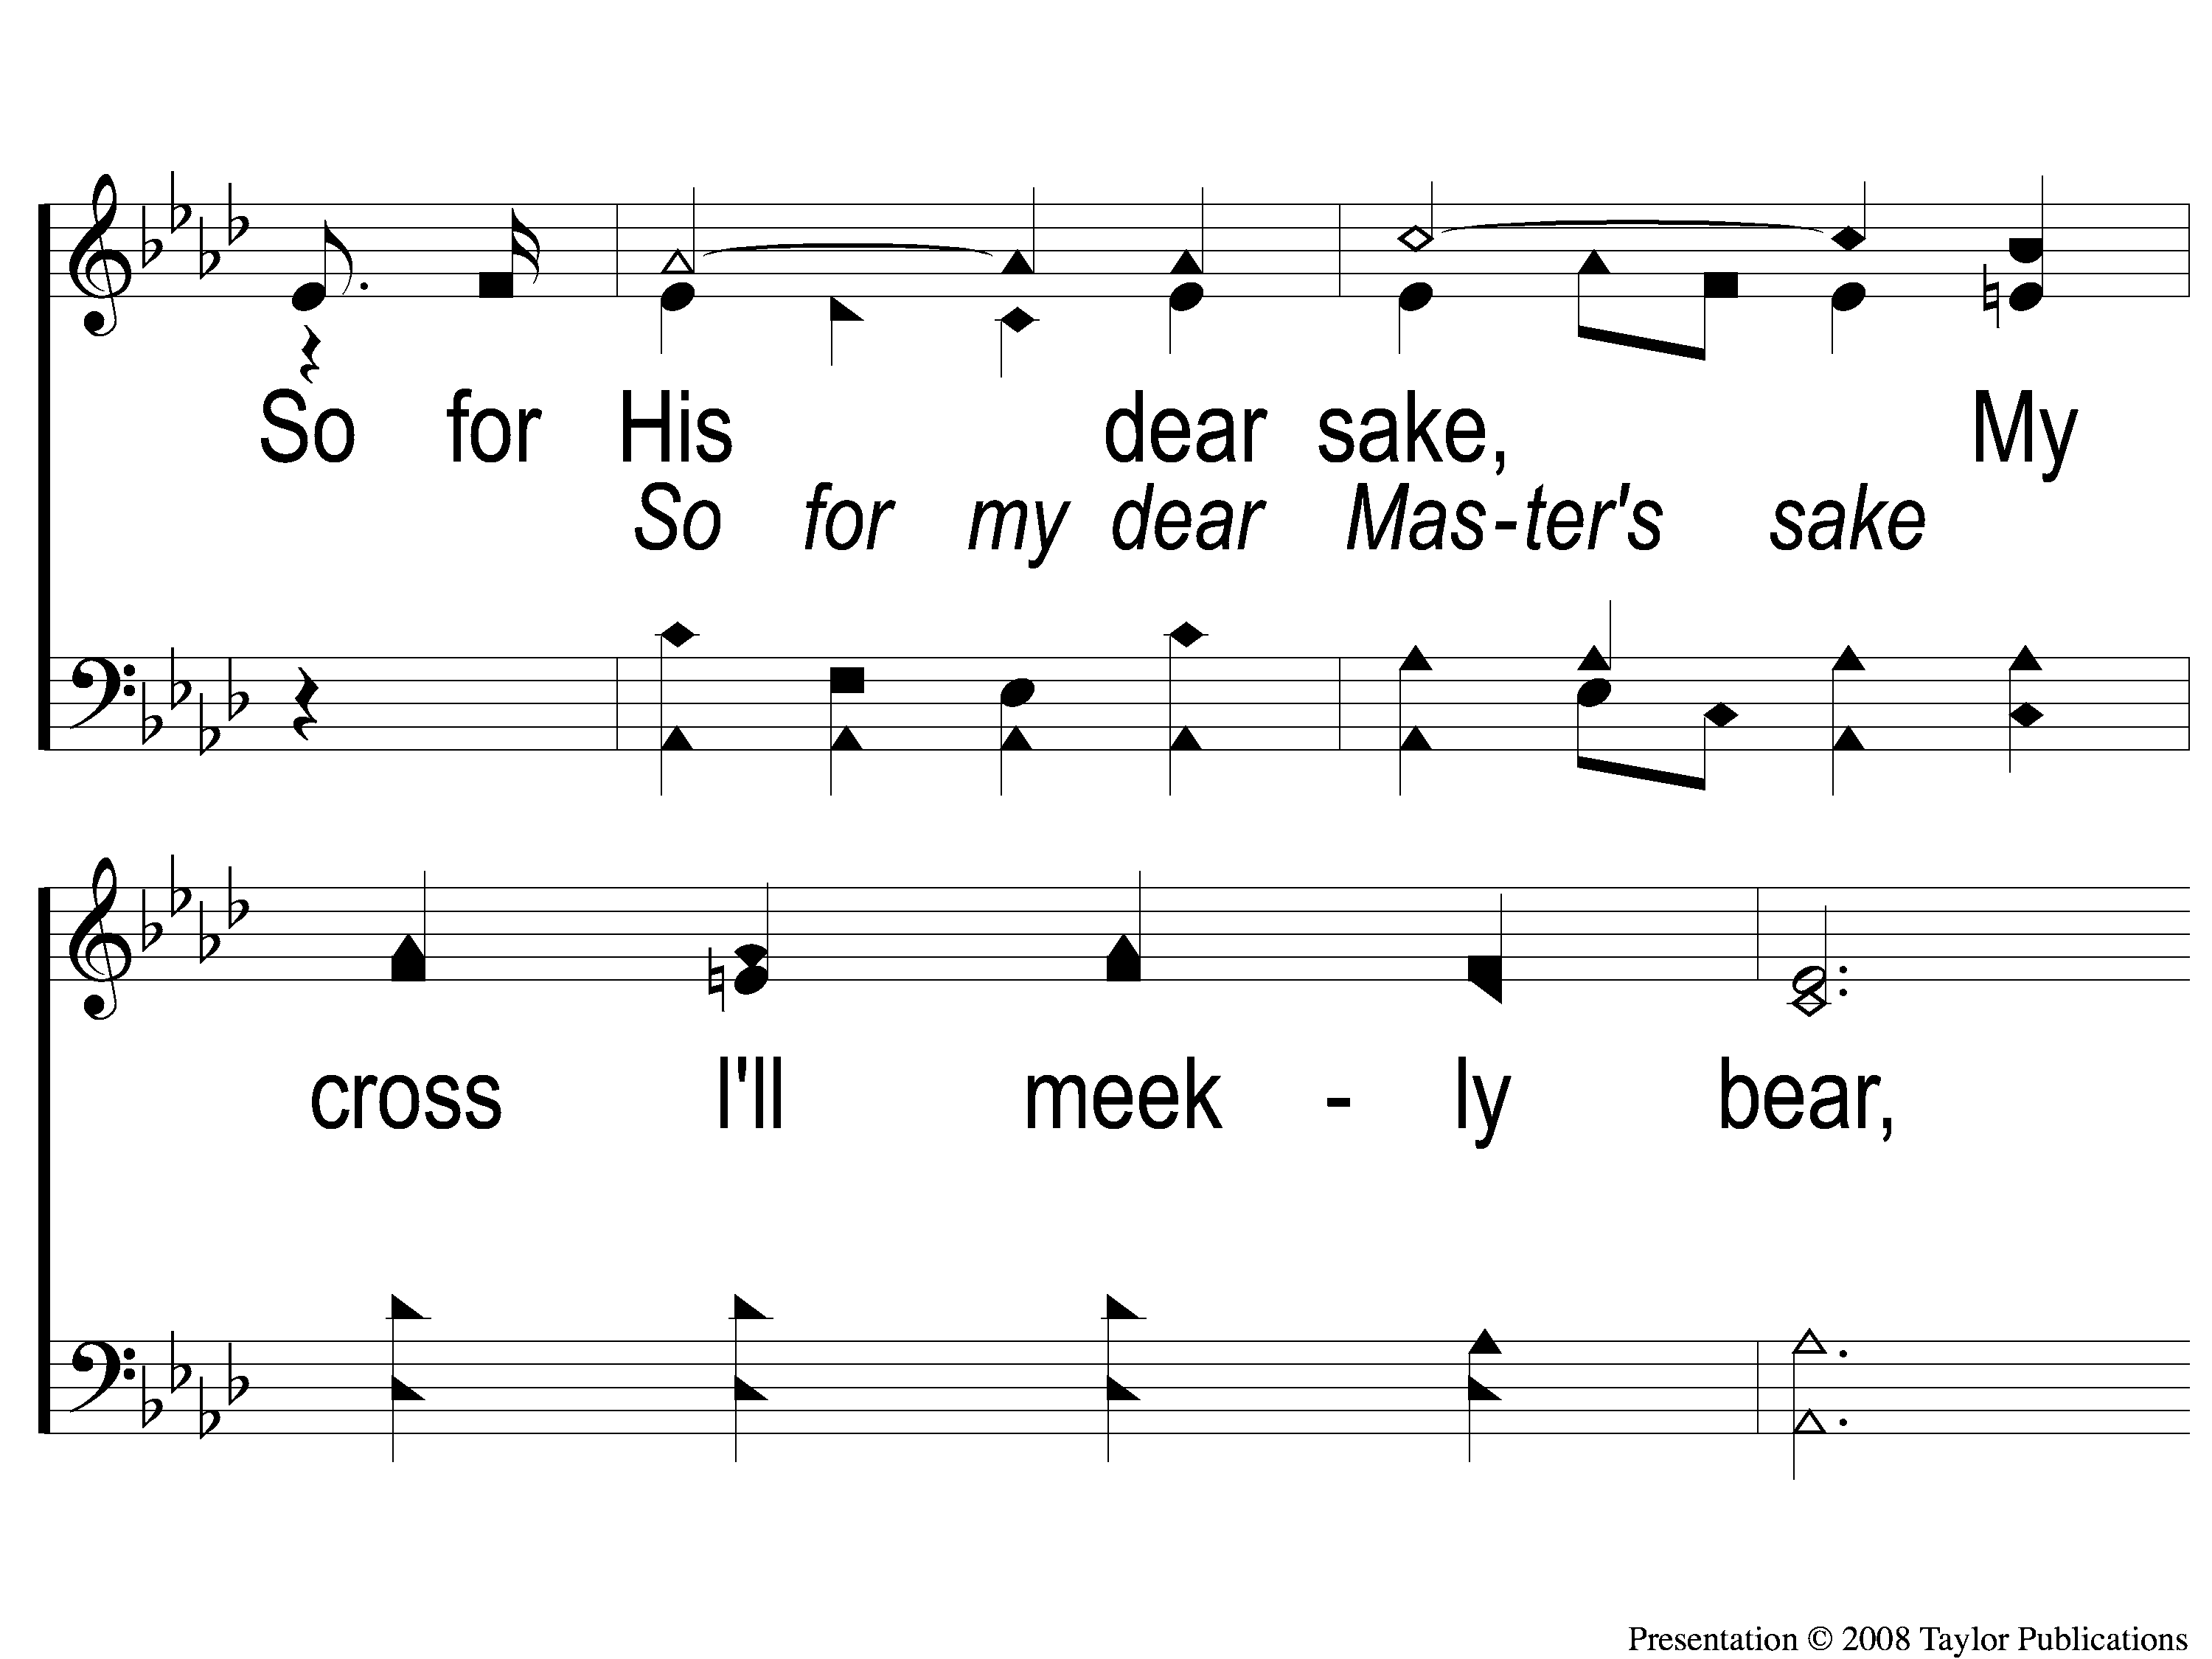
C-3 Anywhere is Home
Anywhere Is Home
24

Slide 8
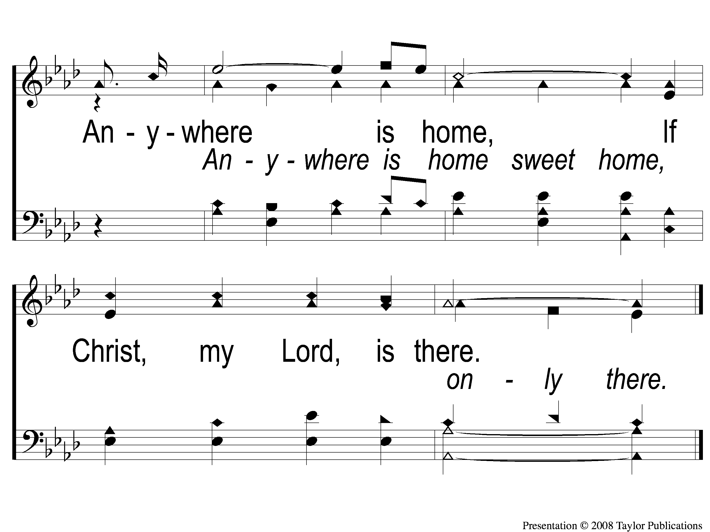
C-4 Anywhere is Home
Anywhere Is Home
24

Slide 9
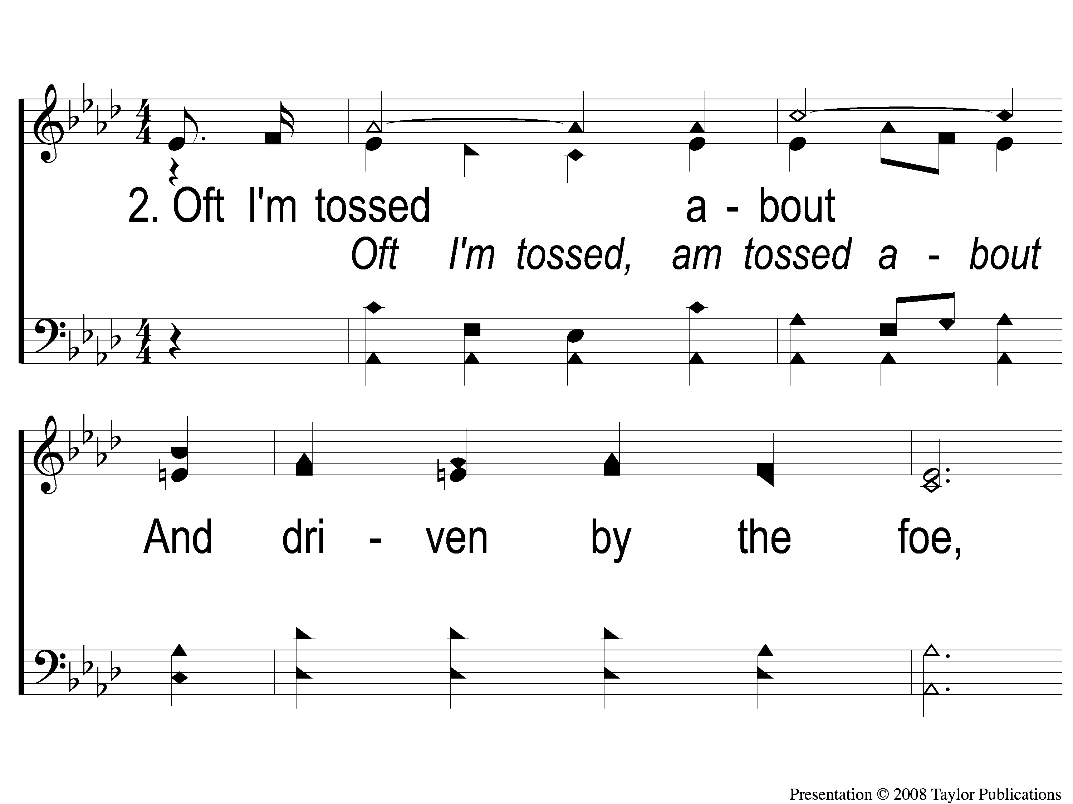
2-1 Anywhere is Home
Anywhere Is Home
24

Slide 10
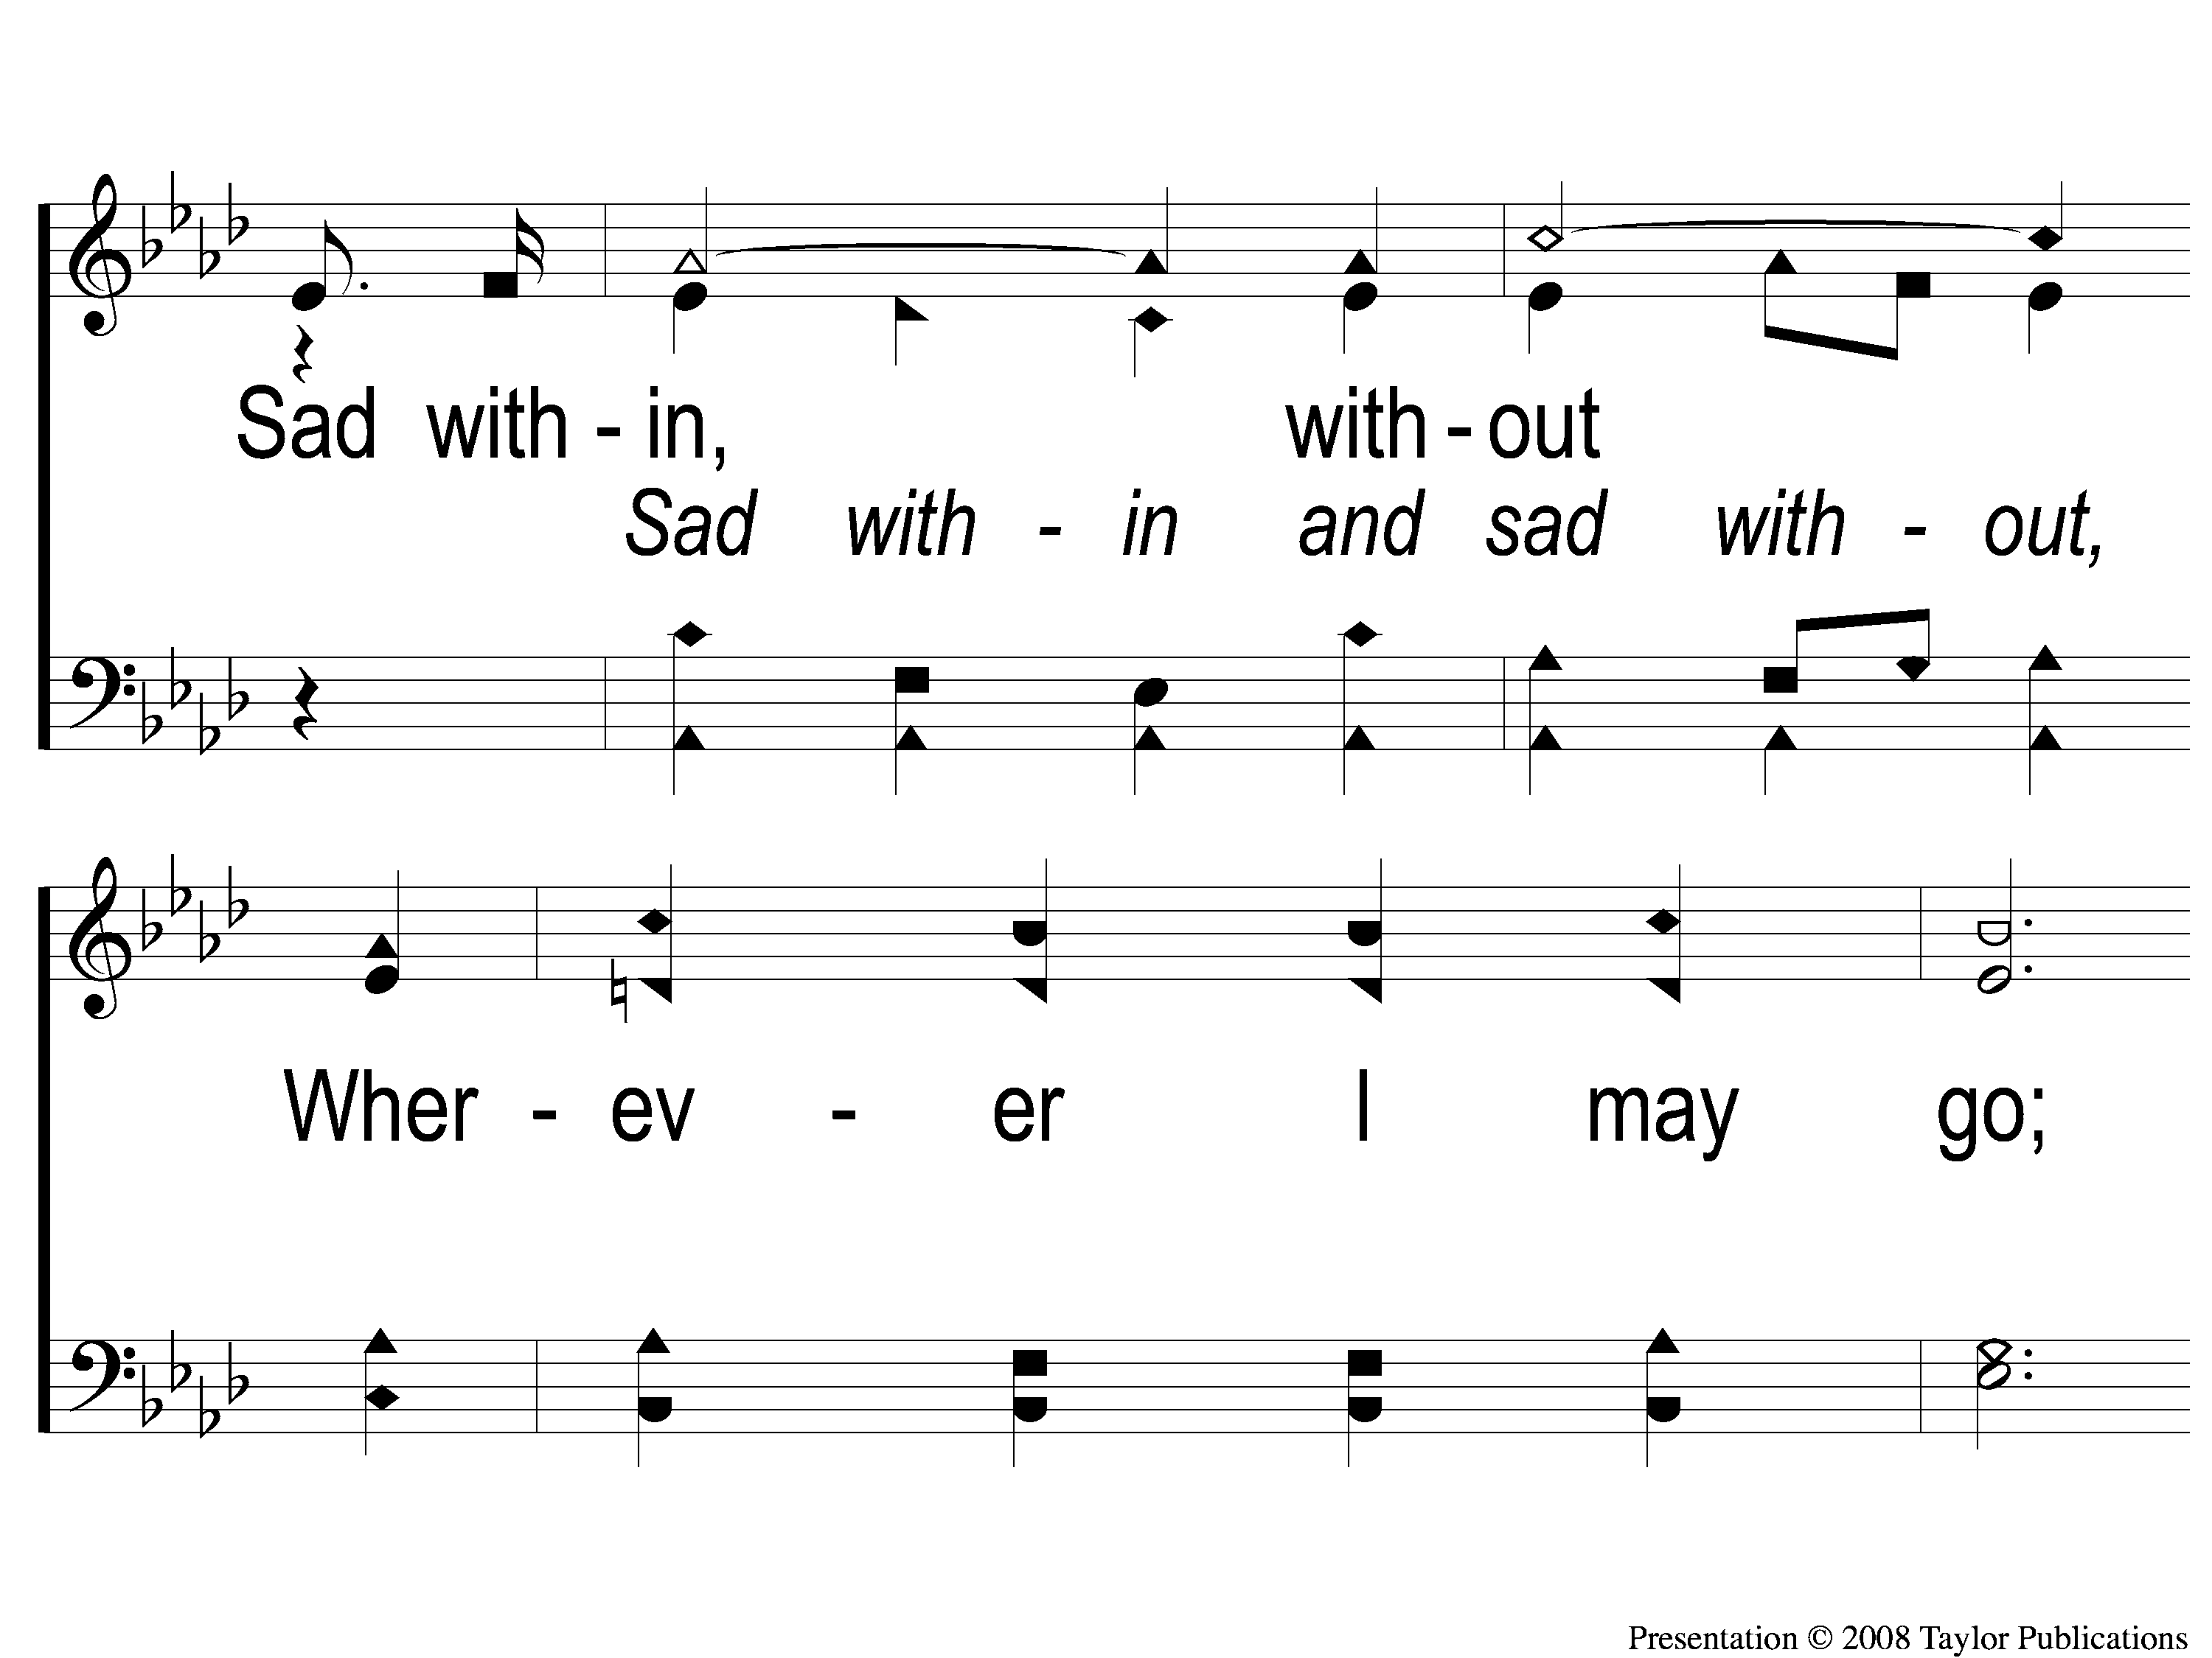
2-2 Anywhere is Home
Anywhere Is Home
24

Slide 11
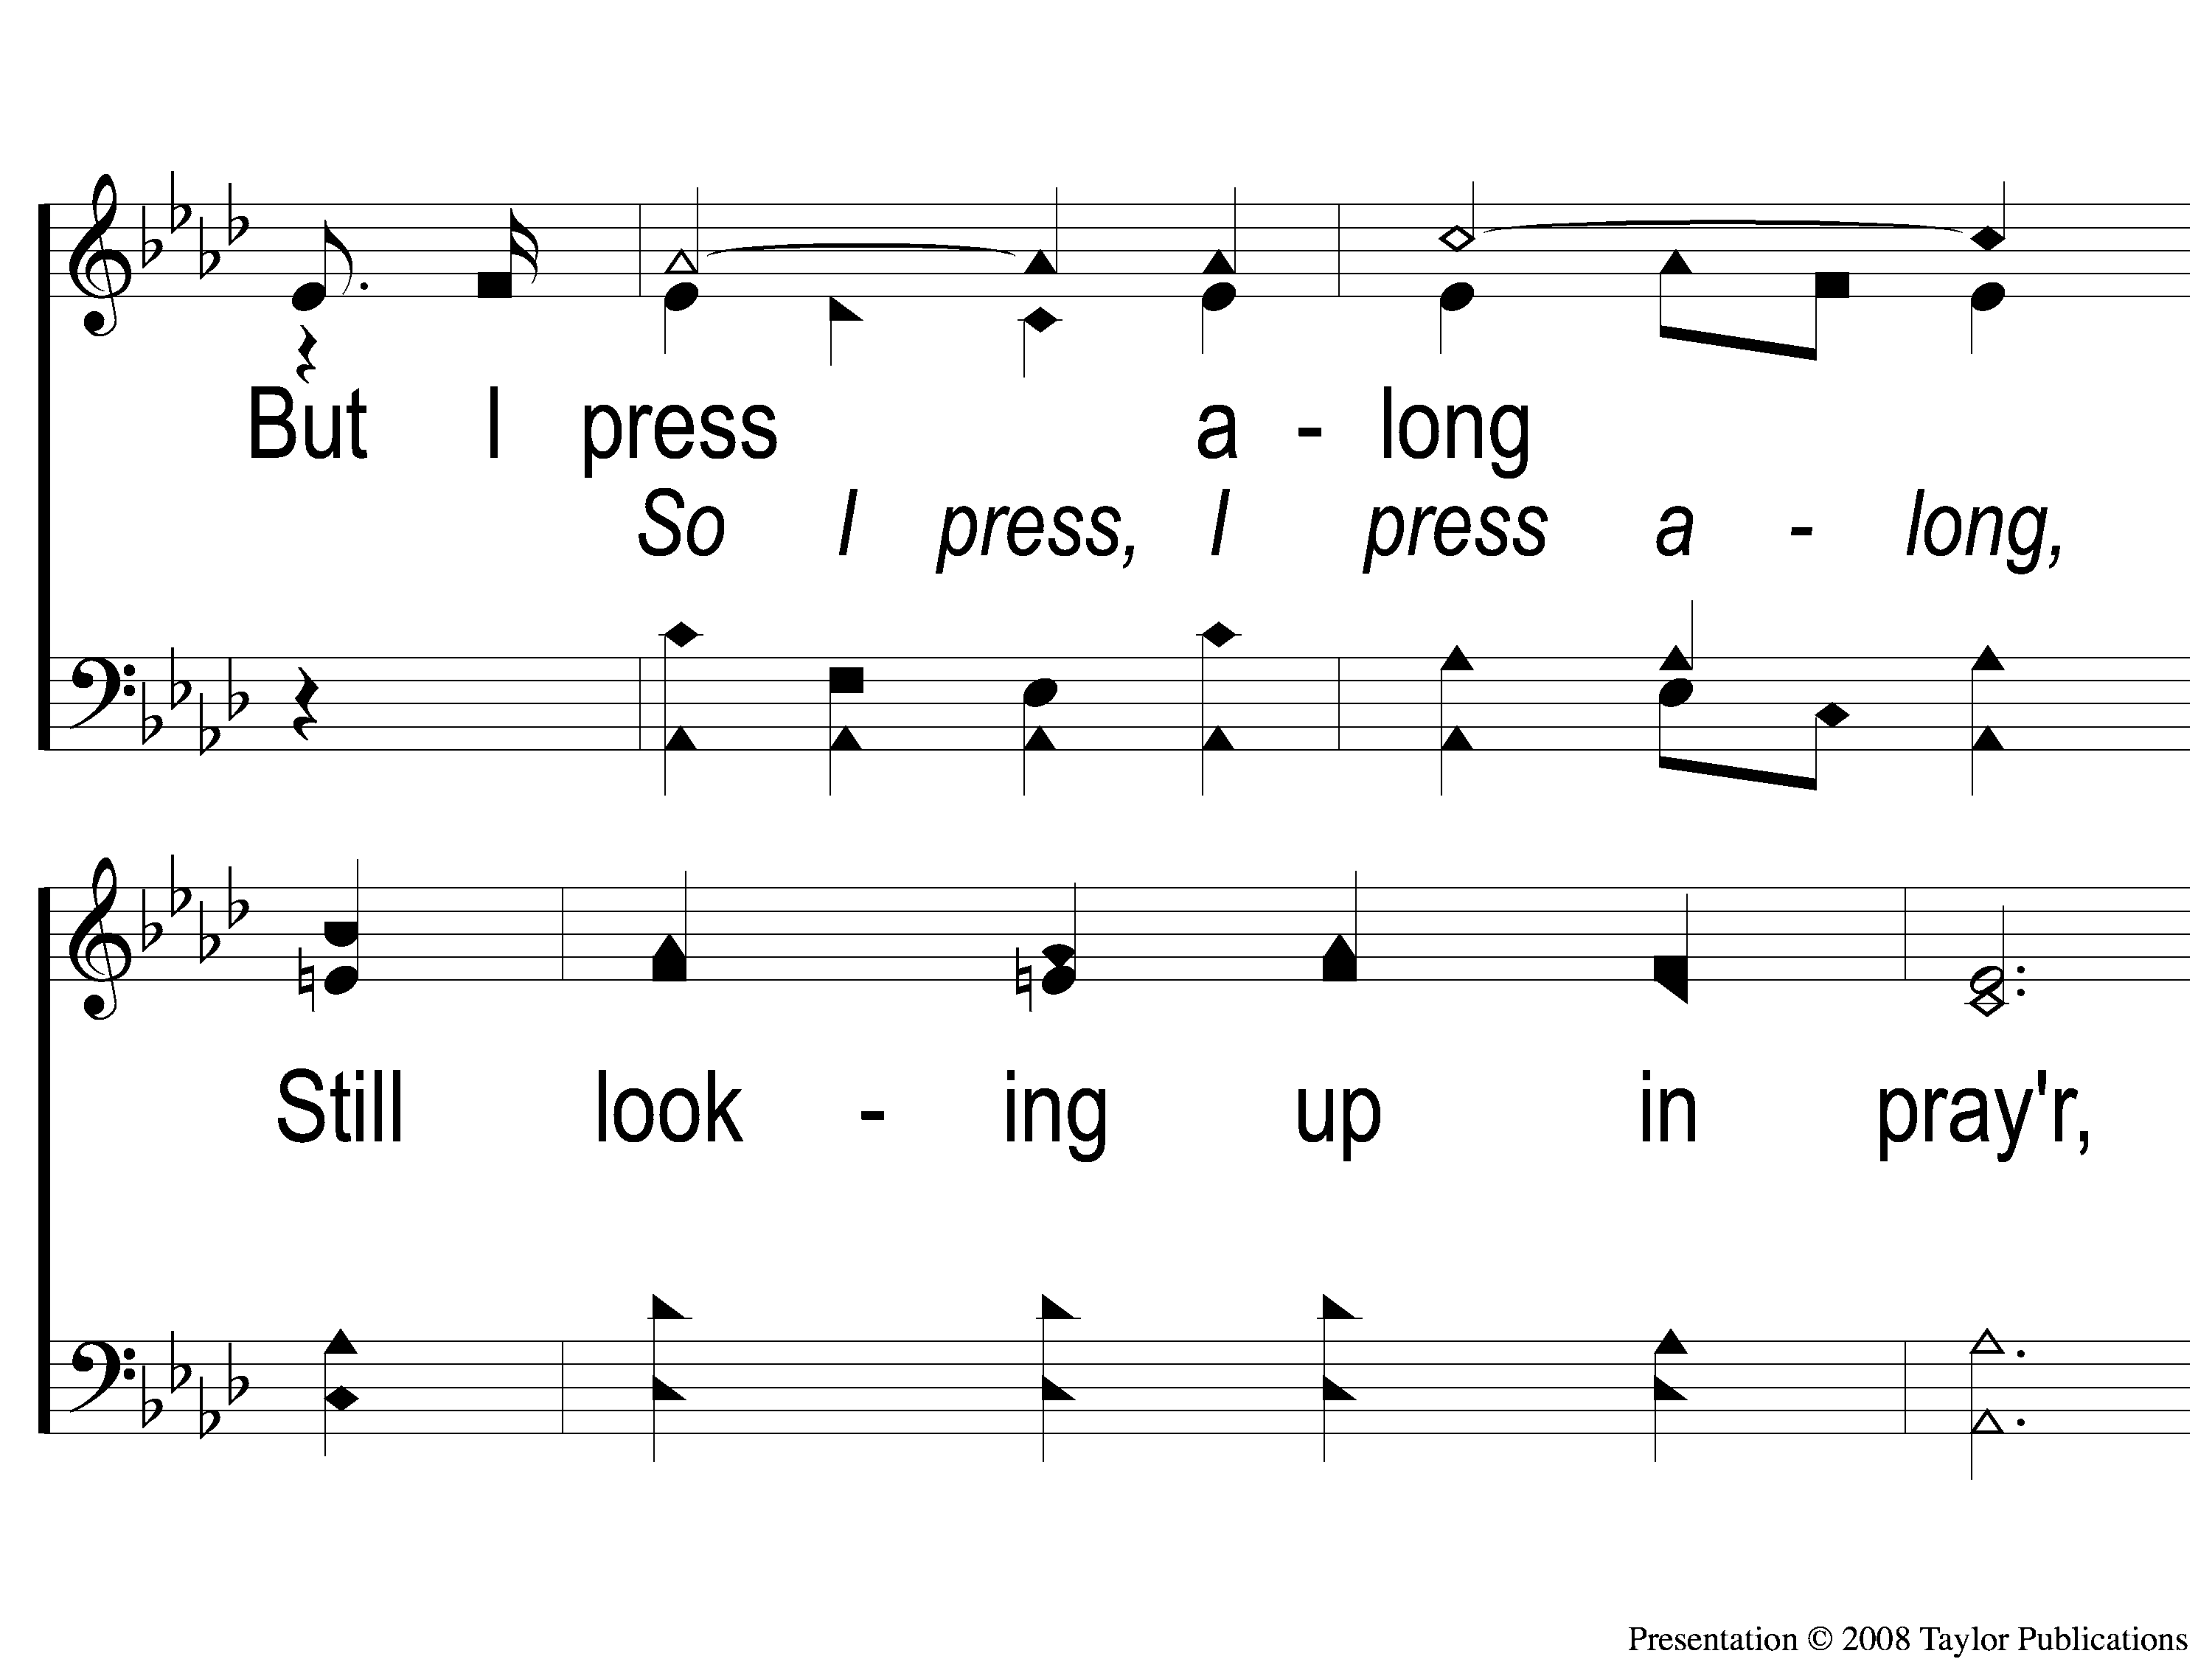
2-3 Anywhere is Home
Anywhere Is Home
24

Slide 12
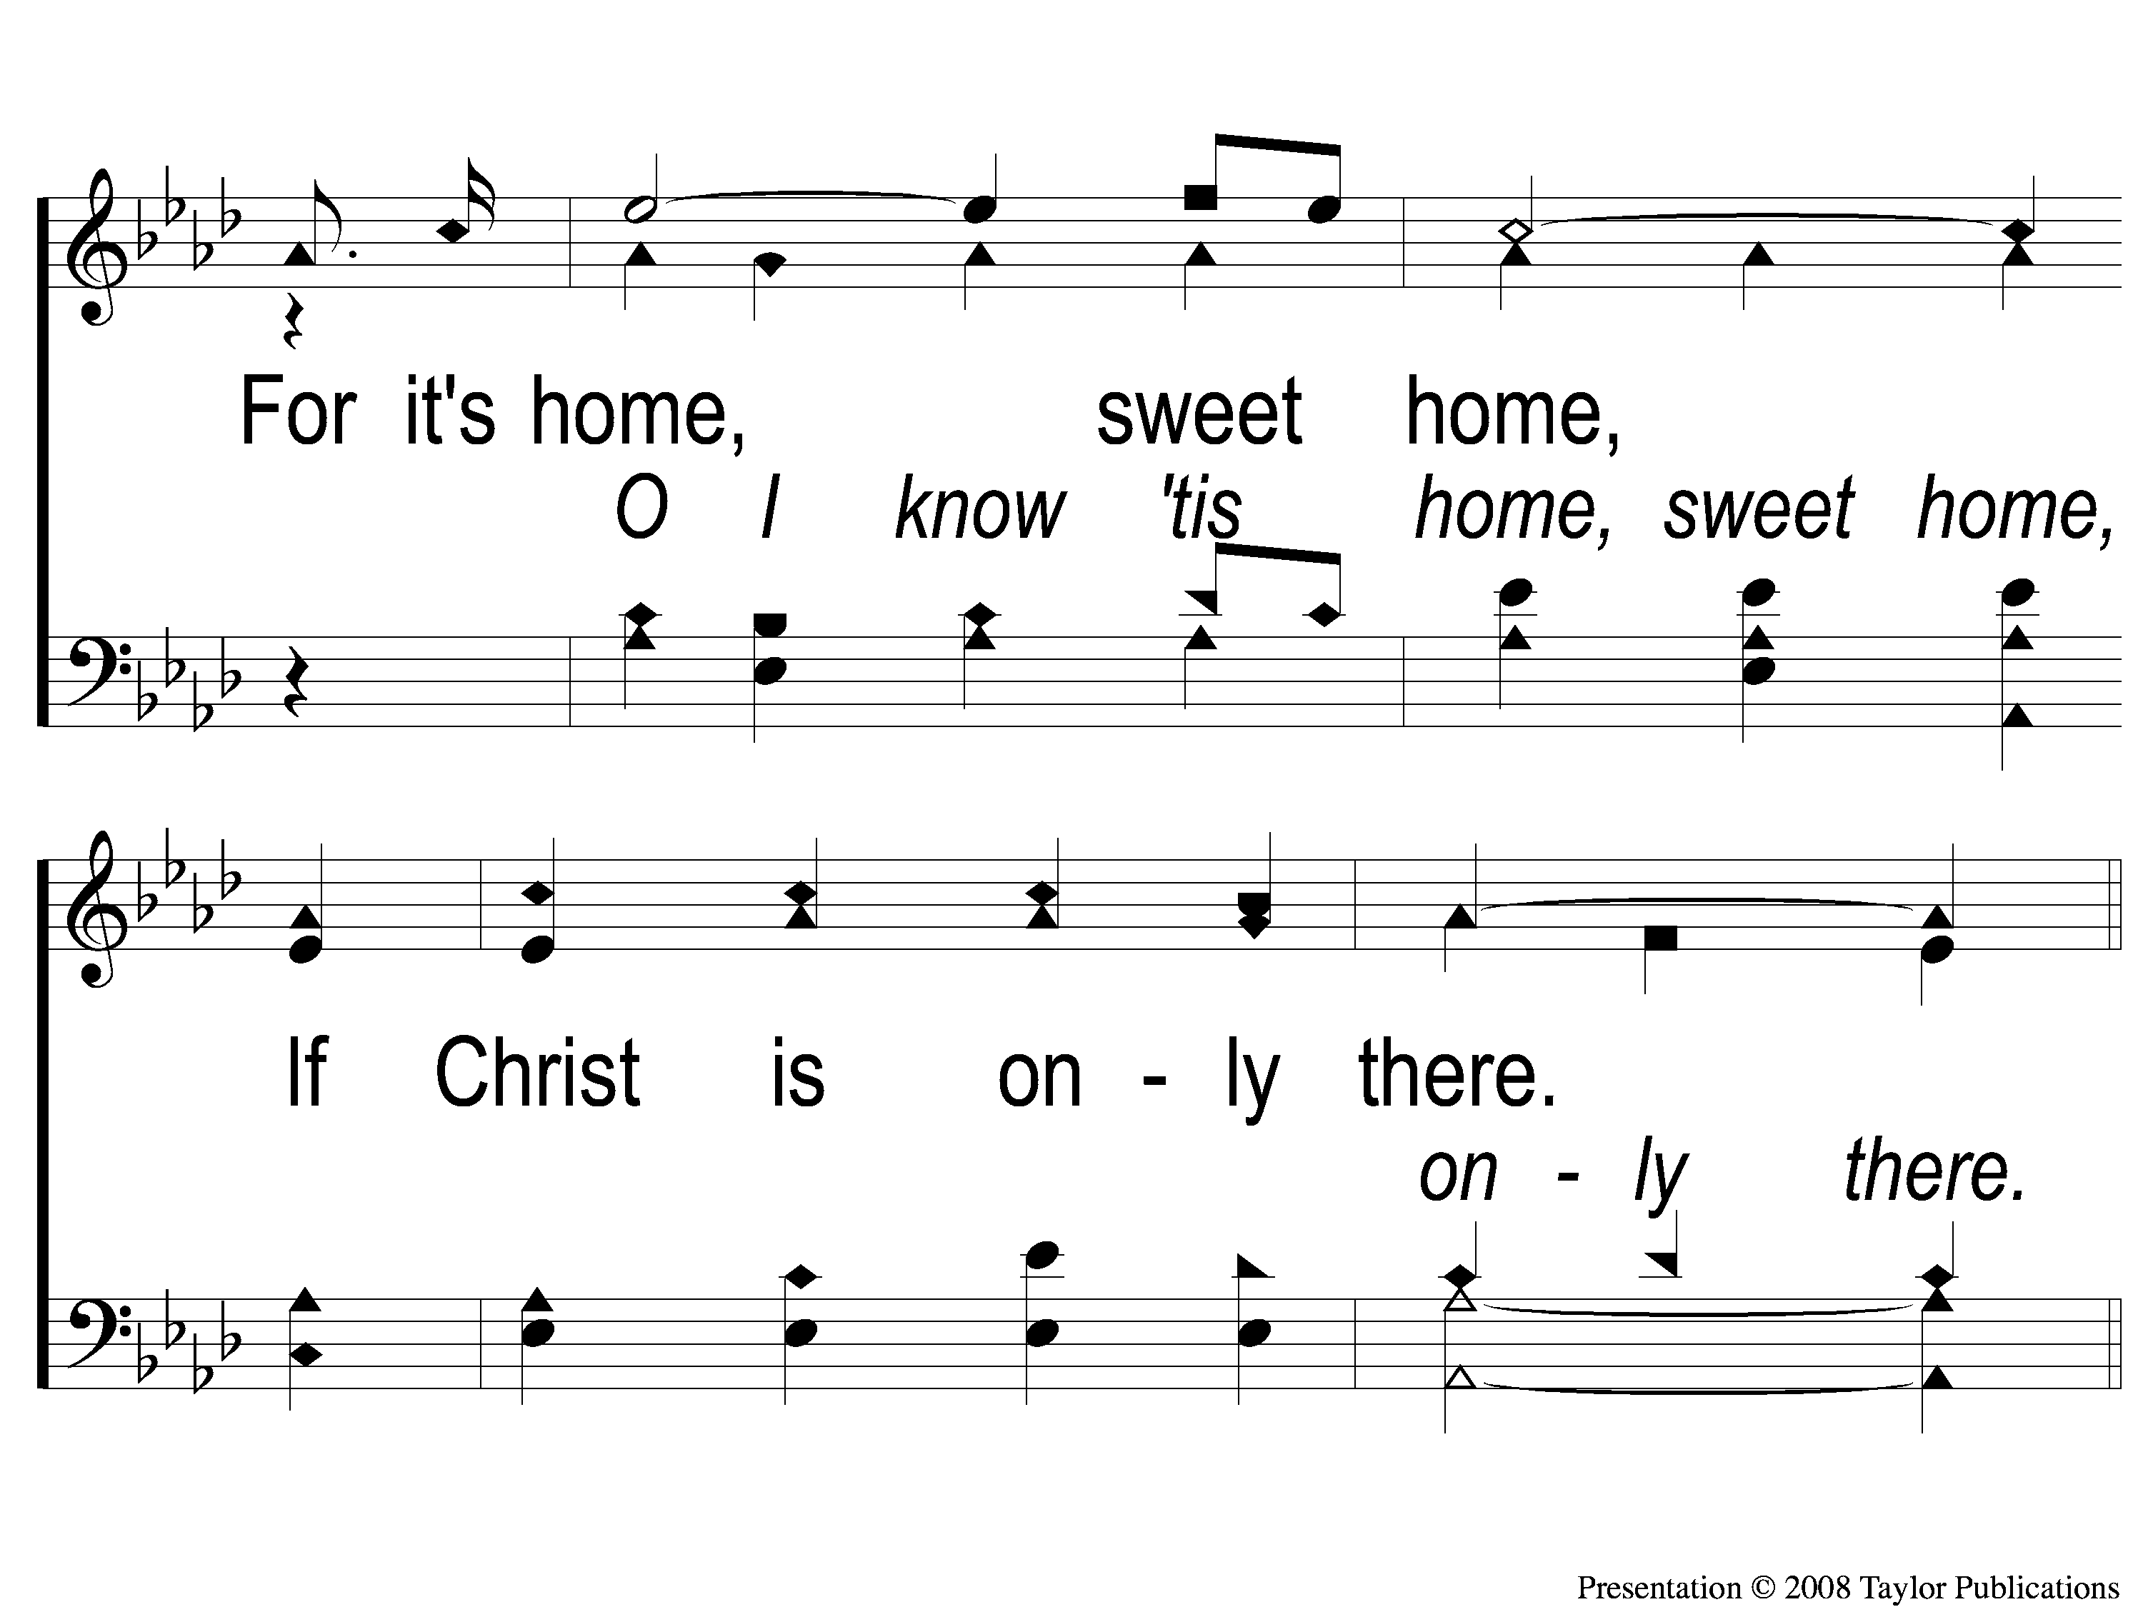
2-4 Anywhere is Home
Anywhere Is Home
24

Slide 13
C-1 Anywhere is Home
Anywhere Is Home
24

Slide 14
C-2 Anywhere is Home
Anywhere Is Home
24

Slide 15
C-3 Anywhere is Home
Anywhere Is Home
24

Slide 16
C-4 Anywhere is Home
Anywhere Is Home
24

Slide 17
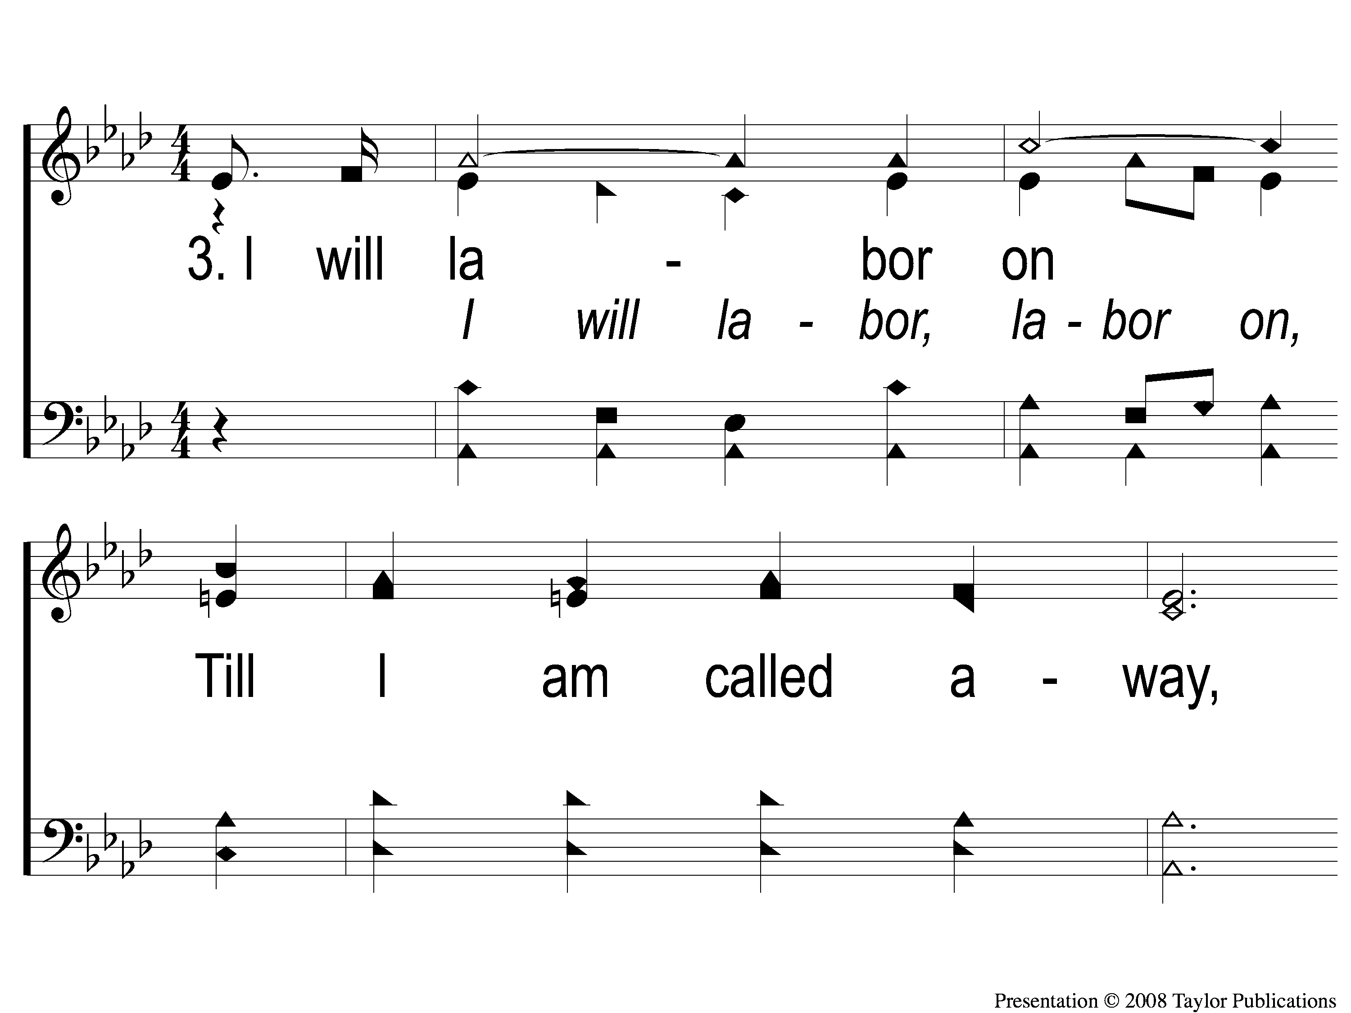
3-1 Anywhere is Home
Anywhere Is Home
24

Slide 18
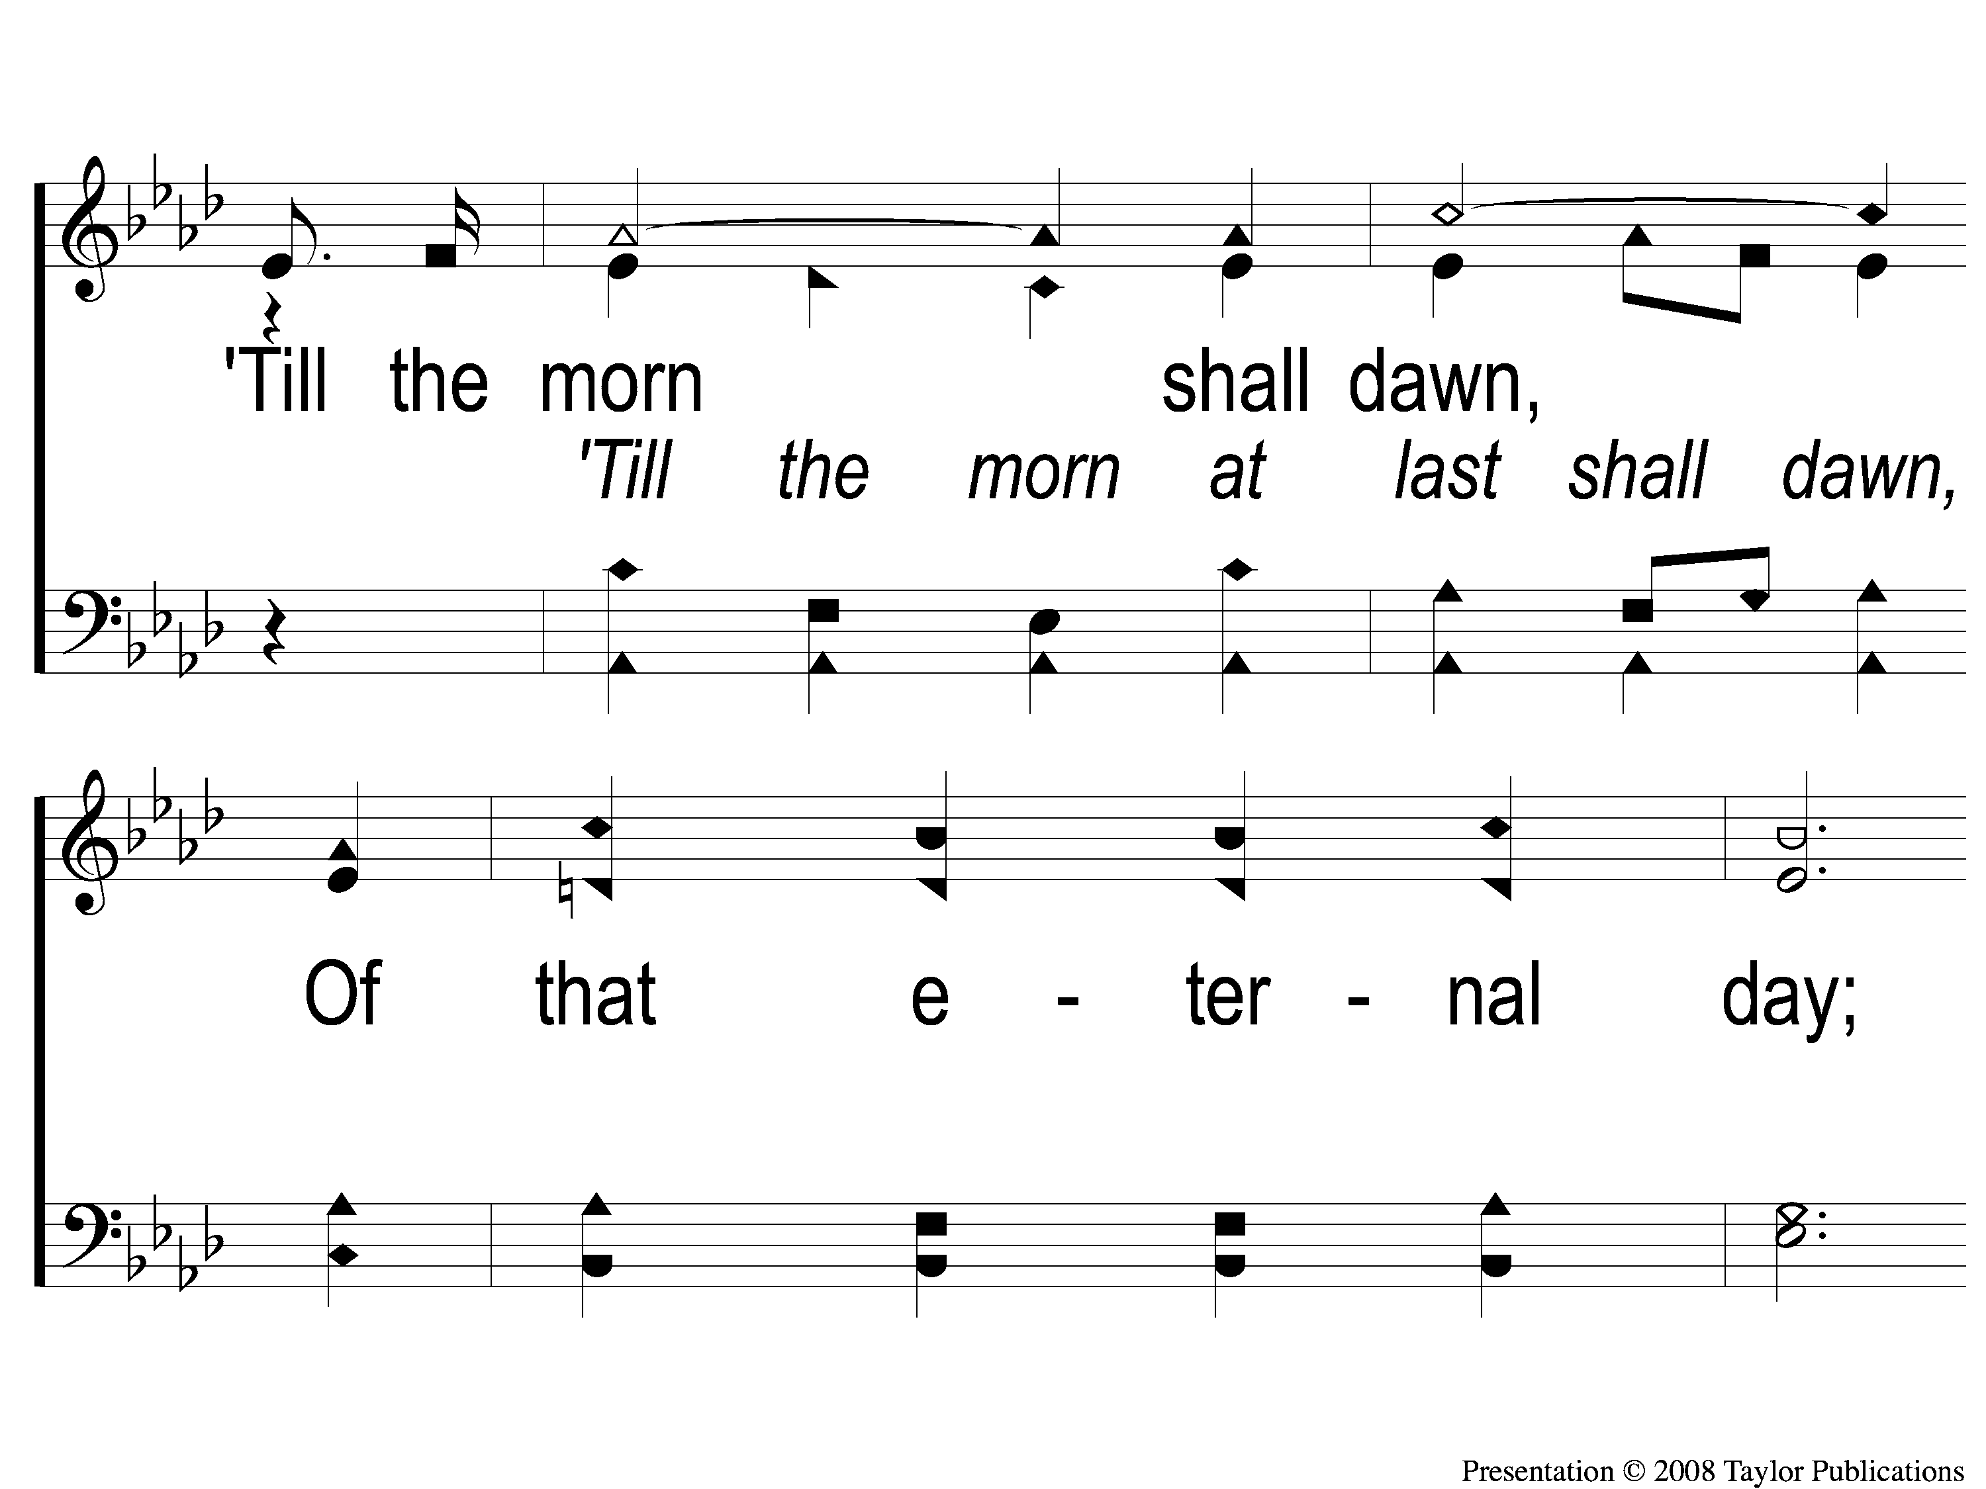
3-2 Anywhere is Home
Anywhere Is Home
24

Slide 19
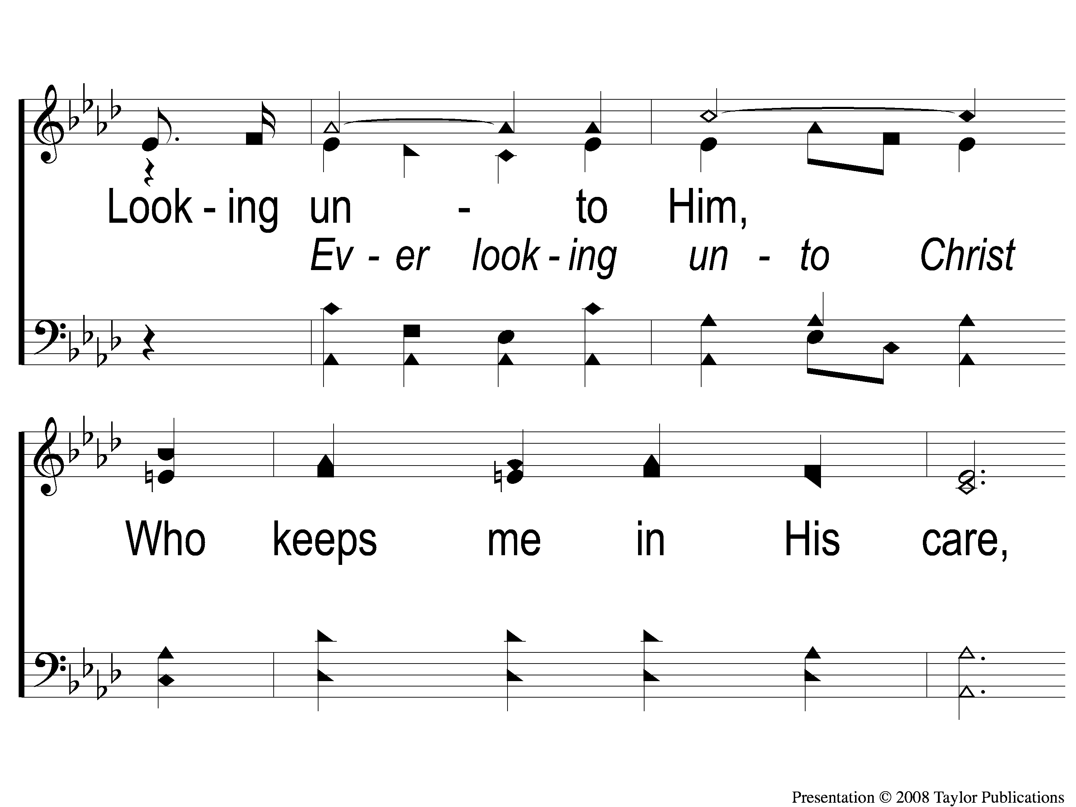
3-3 Anywhere is Home
Anywhere Is Home
24

Slide 20
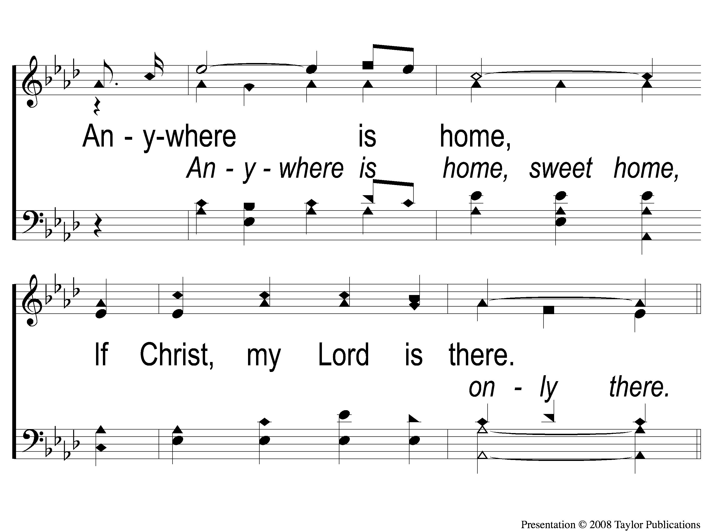
3-4 Anywhere is Home
Anywhere Is Home
24

Slide 21
C-1 Anywhere is Home
Anywhere Is Home
24

Slide 22
C-2 Anywhere is Home
Anywhere Is Home
24

Slide 23
C-3 Anywhere is Home
Anywhere Is Home
24

Slide 24
C-4 Anywhere is Home
Anywhere Is Home
24

